Slide 1


Military Intelligence Part I
John Beverley
Assistant Professor, University at Buffalo
Co-Director, National Center for Ontological Research
Affiliate Faculty, Institute of Artificial Intelligence and Data Science

Slide 2
Outline
Modern Warfare
Coordination by Standardization
Coordination by Ontologies as Standardization

Slide 3
Outline
Modern Warfare
Coordination by Standardization
Coordination by Ontologies as Standardization

Slide 4
Individual Exercise
Do not gather into groups; rather, provide a definition based on your own knowledge for the following terms
Armed Forces
Military
Do not use outside research

Slide 5
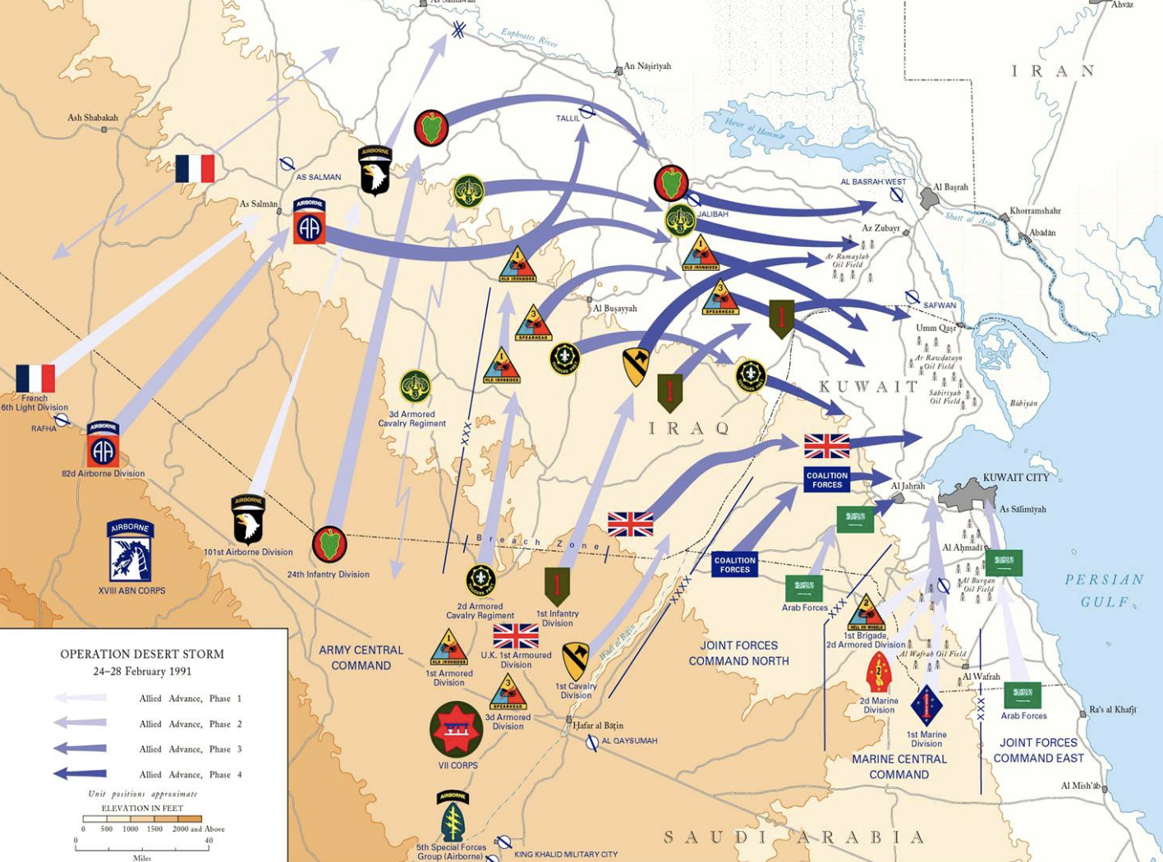
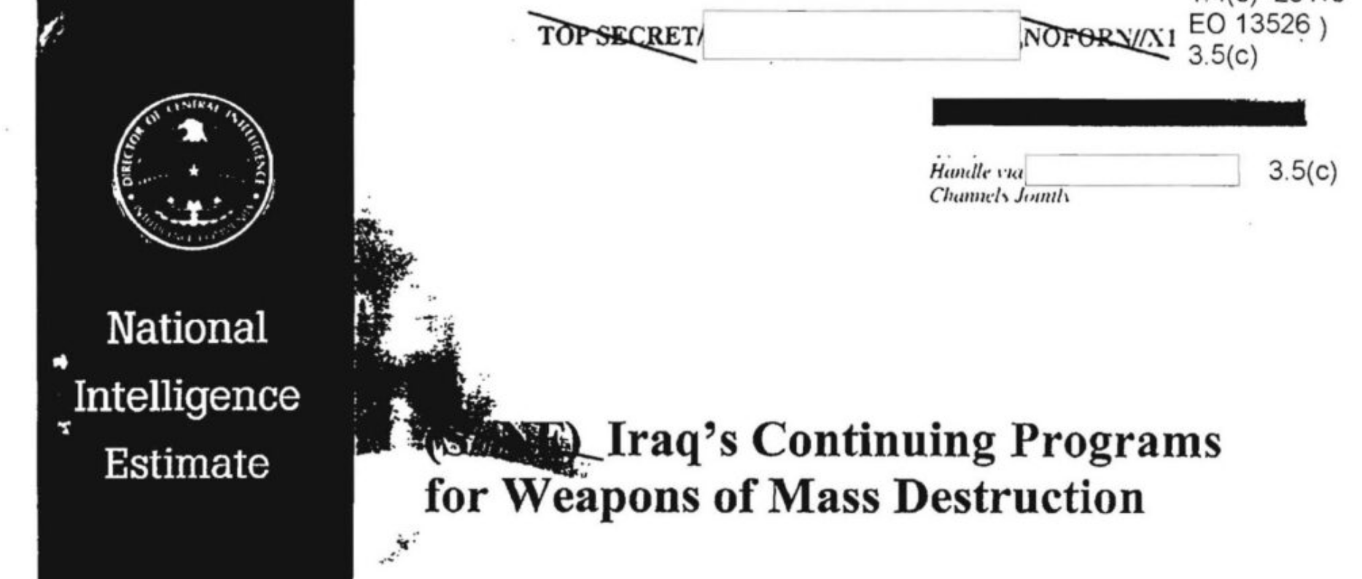
Directions of Fit for Ontology Engineering
Ontology engineering strategies can be distinguished by direction of fit
World-to-Word: Make world fit the words, e.g. conceptualism
Word-to-World: Make words fit the world, e.g. realism

Slide 6
Conceptualism
“An ontology is a specification of a conceptualization” –Gruber, 1992
Interpreted as claiming that ontologies represent concepts
“Taking a more pragmatic view, one can say that ontology is a tool and product of engineering and thereby defined by its use.” –Gruber, 2009
Interpreted as claiming ontologies represent what they need to represent

Slide 7
Realism
Ontologies are a specification of the world
If we attempt to go from the words we use to the world, it is unlikely that we will end up in the same place
If we attempt to go from the world to the words we use, it is more likely we will remain coordinated

Slide 8
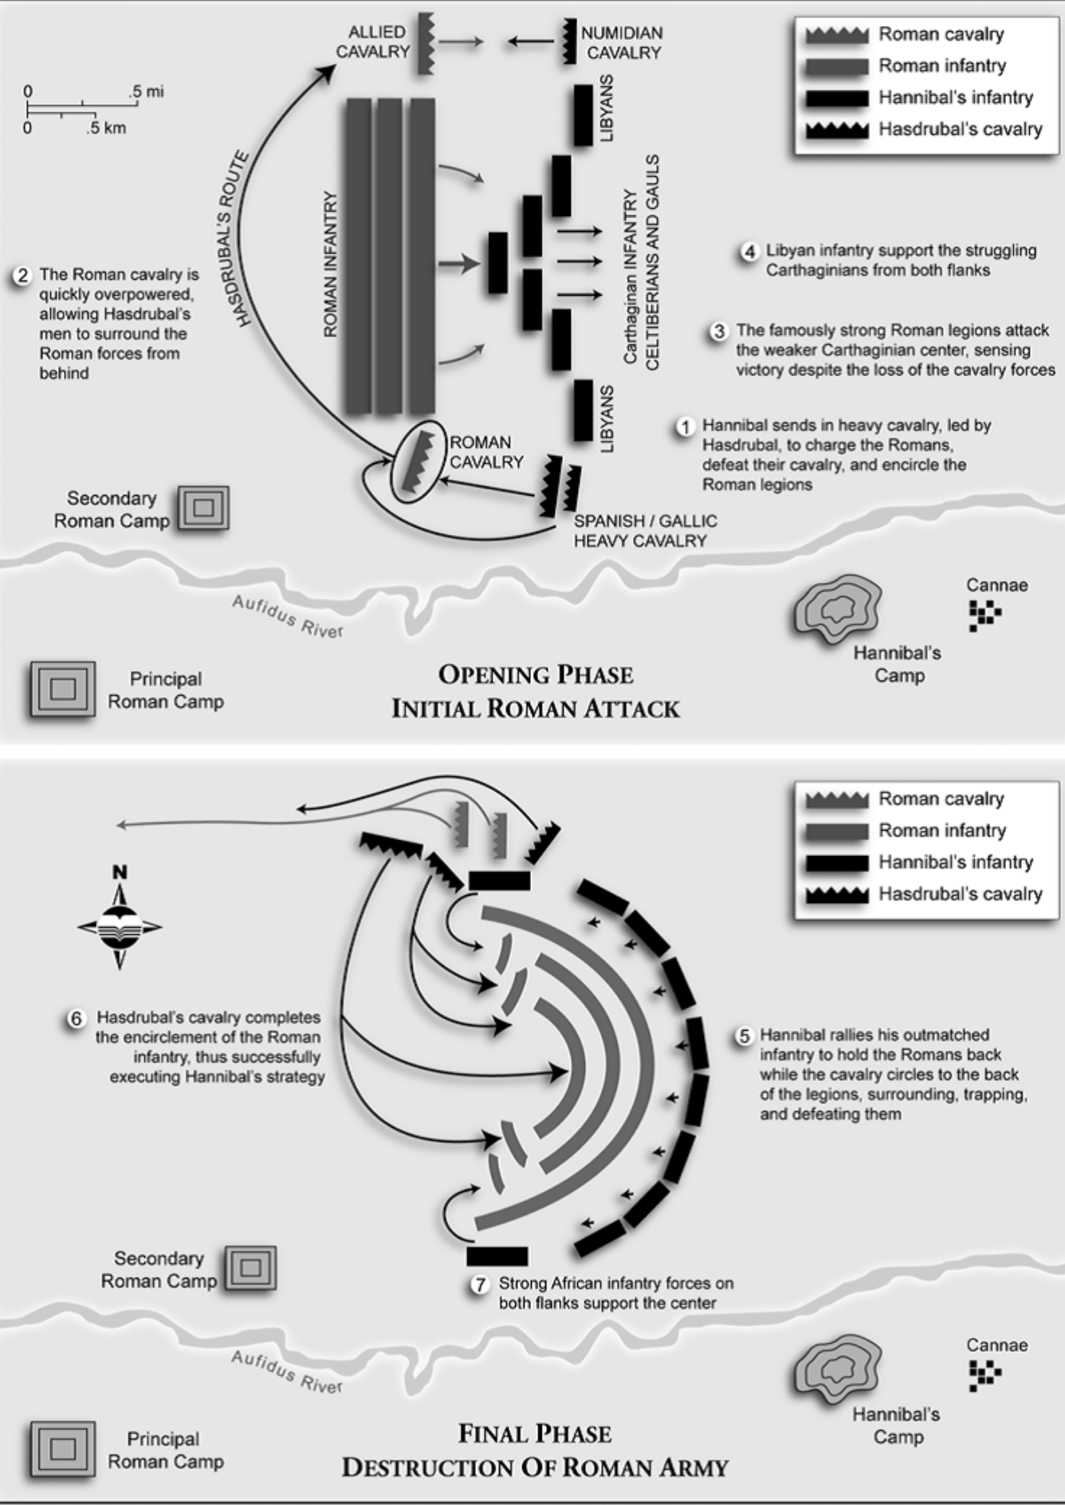
Classical Warfare
Battle of Cannae; Second Punic War
Romans pushed through the center of Hannibal’s troops, with the goal of splitting his army; Hannibal’s elite troops encircled the Roman army

Slide 9
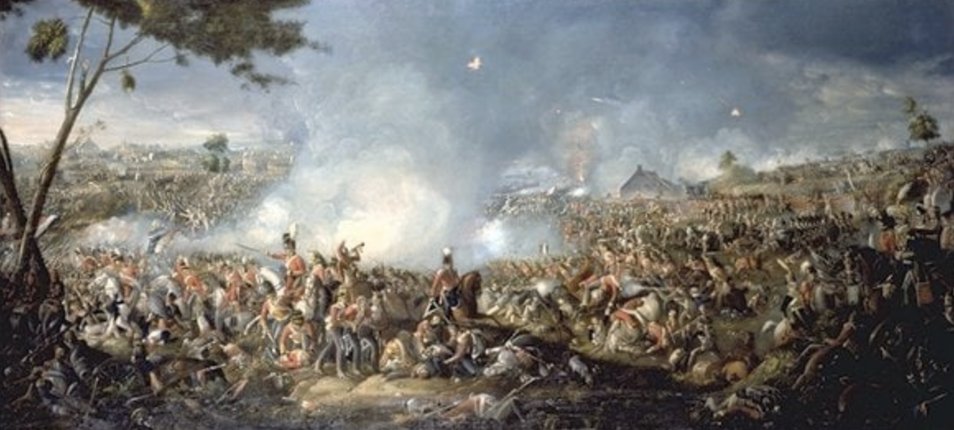
Early Modern Warfare
Characterized by widespread use of gun powder, explosives, and professional armies
Greater reliance on strategy and intelligence
Massive increase in number of deaths

Slide 10
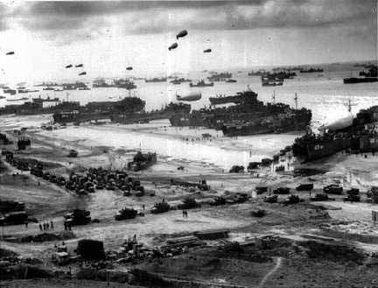
Modern Warfare
Characterized by weapons of mass destruction, stealth, and massive coordination of resources
Expansion of routine operational environments to include land, sea, and air, as well as digital domains that stretched across participating nations

Slide 11
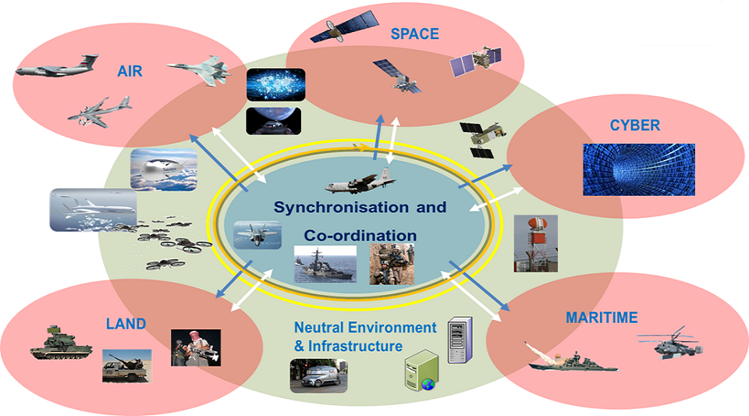
Modern Warfare
Illustration of the electromagnetic warfare domain and required coordination during engagements
Traditional warfare has focused on kinetic attack and defense, i.e. physical damage to people and infrastructure

Slide 12
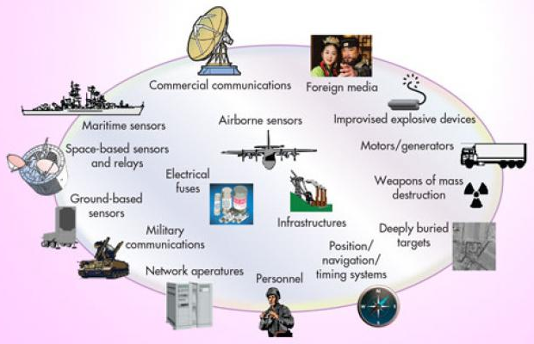
Modern Warfare
Illustration of intersecting operational areas requiring dedicated attention during engagement
Modern warfare shifts towards non-kinetic attack and defense, i.e. towards digital or cyber attacks

Slide 13
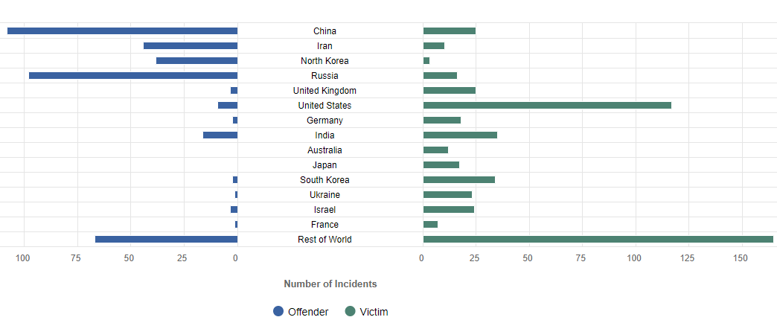
Significant Cyber Incidents since 2006
Notes:
https://www.csis.org/programs/cybersecurity-and-governance/technology-policy-program/other-projects-cybersecurity

Slide 14
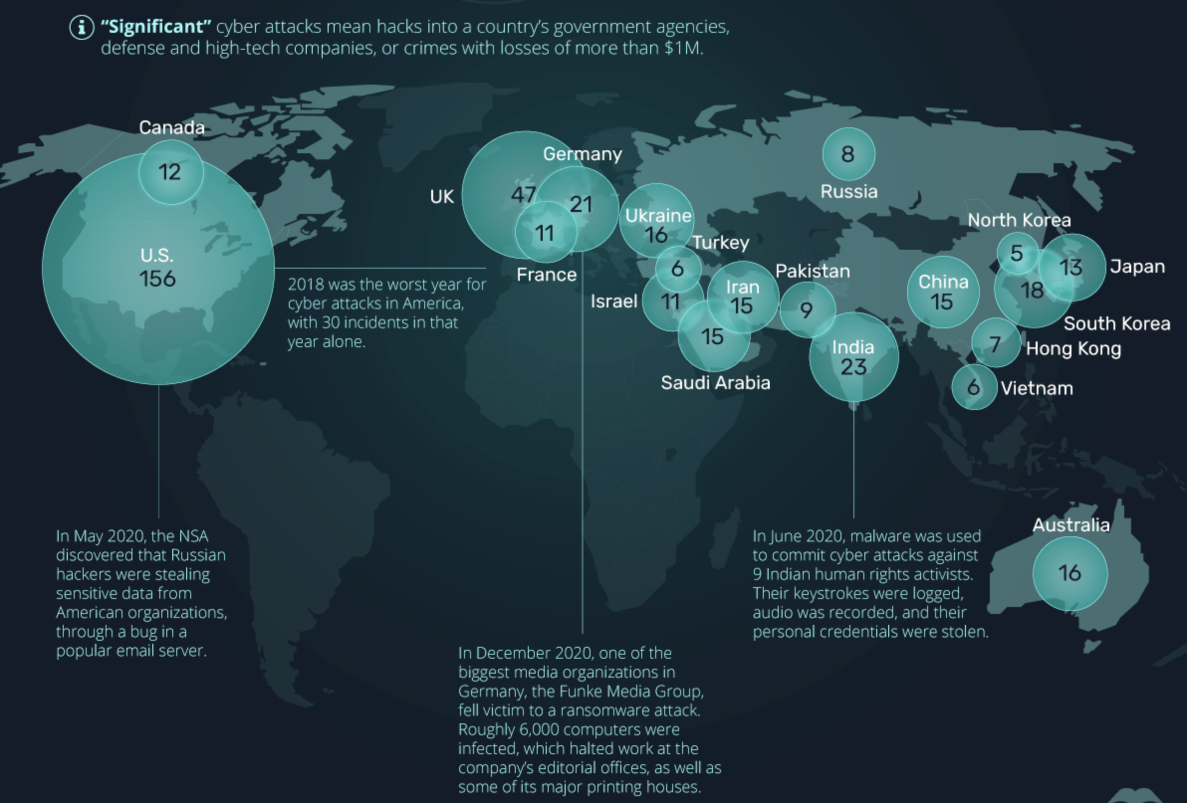

Slide 15
Outline
Modern Warfare
Coordination by Standardization
Coordination by Ontologies as Standardization

Slide 16
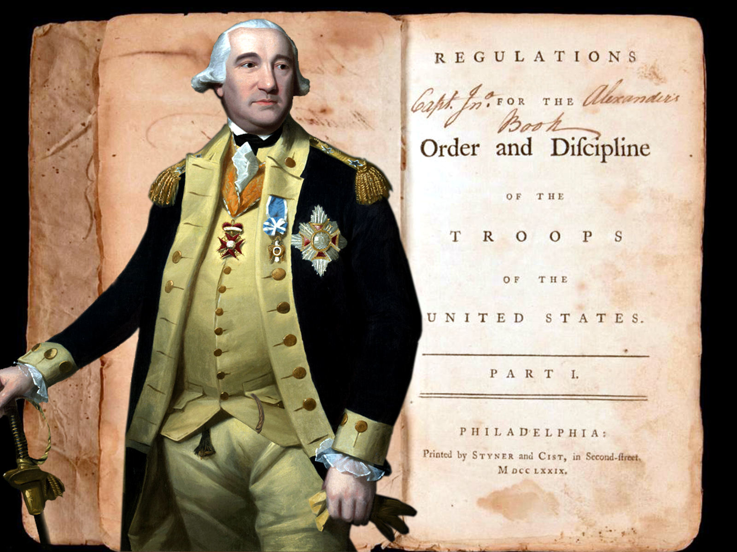
First U.S. Army Drill Manual
Regulations for the Order and Discipline of the Troops of the United States
Compiled by Baron de Steuben, Inspector General of the Continental Army, 1779
Codified strategies for joint military efforts during engagement

Slide 17
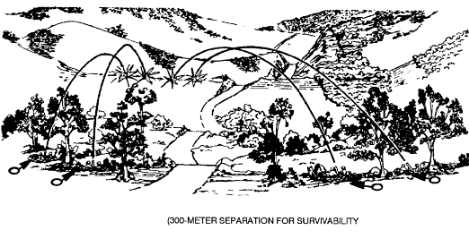
Doctrine of Massing Fires
Coordinated dispersed artillery on single target
Required:
Real-time coordination
Common operational view
Interoperable artillery
Achieved by:
New information support strategies and governance
New training

Slide 18
Importance of Standardization
Massing fires was a strategy that could be realized by militaries long before Steuben outlined it in 1779
The actual doctrine for massing fires was approved only in 1939
The codification of massing fires enabled progressive refinement of this military capability over time
Aided by professionalization of armed forces, including signals indicating who can be trusted in battle, training, etc.

Slide 19
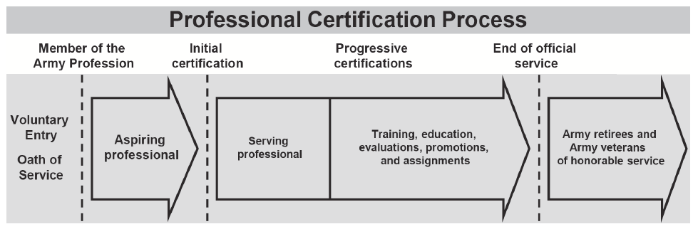
Professional Militaries
The goal of training, credentialing, evaluating, and continuous re-engineering is the create habits aimed towards pre-coordination of intermeshed plans and different levels, so soldiers will coordinate spontaneously when executing the sorts of actions for which they have been trained.

Slide 20
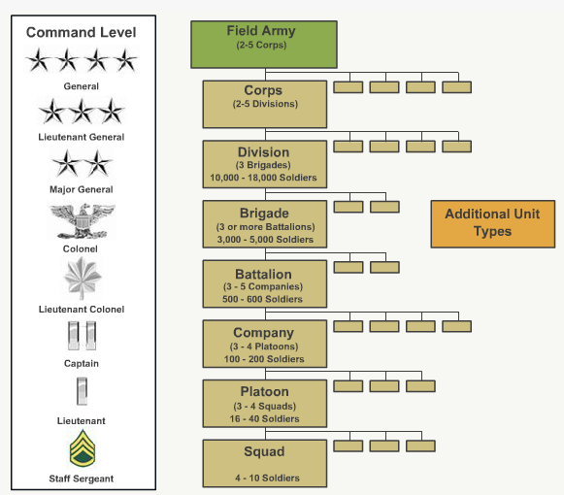
Rank
Creating new types of credentials through which soldiers may be promoted, provides trustworthy standards for vetting expertise
Which in turn creates new strategic and operational team arrangements and activities
See Shane Babcock’s Military Rank Ontology

Slide 21

Epistemic Communities

Slide 22
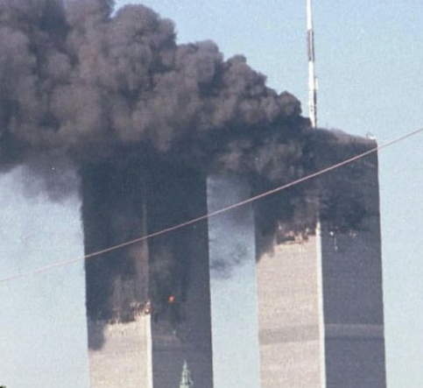
Anticipating Massing Intelligence Fires
9-11 illustrated challenges of predicting massing fires from intelligence failures
Prediction requires:
Real-time information sharing and revising
Common operational perspective
Interoperability across activities
Which will require:
New information support strategies
Semantic interoperability across data
New governance and training for both humans and machines

Slide 23

Anticipating Massing Intelligence Fires
Agencies too need signals to understand who can be trusted
Prediction requires:
Real-time information sharing and revising
Common operational perspective
Interoperability across activities
Which will require:
New information support strategies
Semantic interoperability across data
New governance and training for both humans and machines

Slide 24
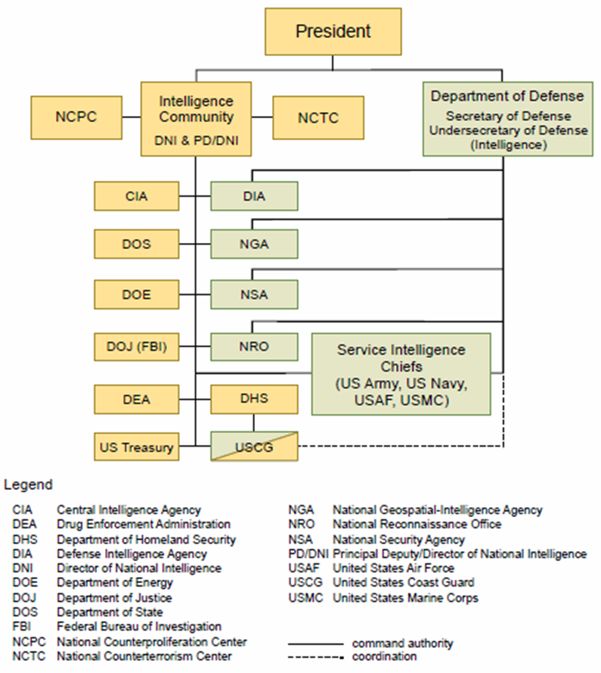
U.S. Intelligence Community (IC)
U.S. government agencies concerned with intelligence activity, either in an oversight, managerial, support, or participatory role.
The IC is an epistemic community:
Normative beliefs about the purpose
Beliefs based on investigating problems in their domain
Standards of accuracy for analyses
Common community goals

Slide 25
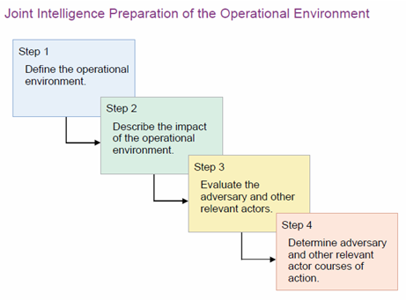
Common Operational Perspective
Common operational perspective connects data to intelligence
Prediction requires:
Real-time information sharing and revising
Common operational perspective
Interoperability across activities
Which will require:
New information support strategies
Semantic interoperability across data
New governance and training for both humans and machines

Slide 26
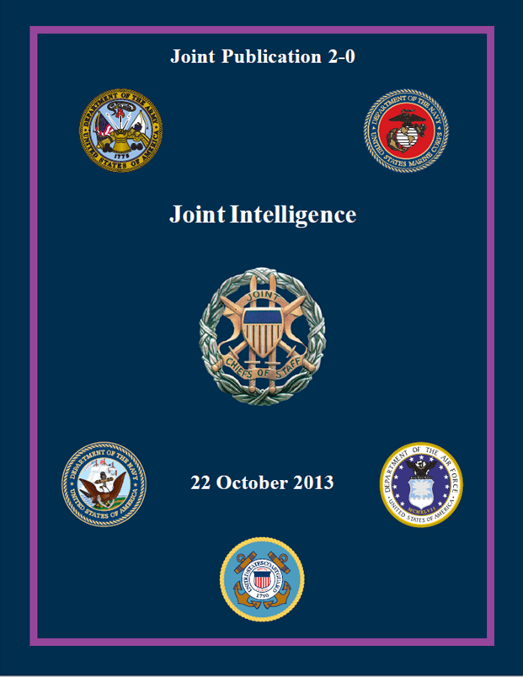
Joint Publications
Activity interoperability involves enforceable prescriptions
Prediction requires:
Real-time information sharing and revising
Common operational perspective
Interoperability across activities
Which will require:
New information support strategies
Semantic interoperability across data
New governance and training for both humans and machines

Slide 27
DOD Definition of Interoperability
“The ability of systems, units, or forces to provide data, information, material, and services to, and accept the same from, other systems, units, or forces, and to use the data, information, material, and services exchanged to enable them to operate effectively together.” -DOD Instruction 8330.01
Importantly, this is not semantic interoperability

Slide 28
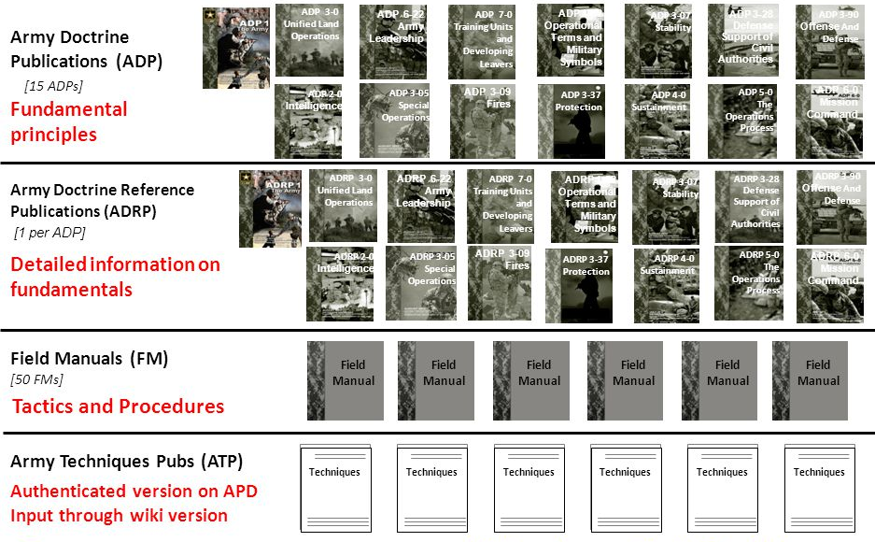
Importance of Standardization
Activity interoperability involves enforceable prescriptions internal to and across agencies
Such as the Army Doctrine Publications, Reference, Field Manuals, and Technique Pubs

Slide 29
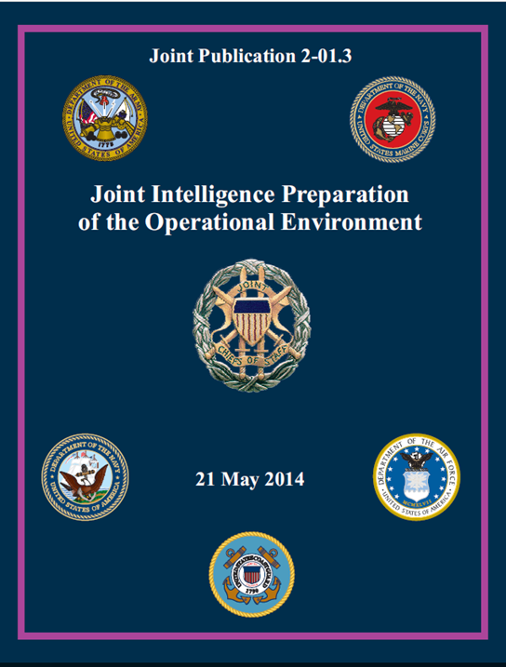
Importance of Standardization
Activity interoperability involves enforceable prescriptions internal to and across agencies
“Governs the analytical process used by joint intelligence organizations to produce intelligence estimates and other intelligence products in support of the joint force commander’s decision-making process.”

Slide 30
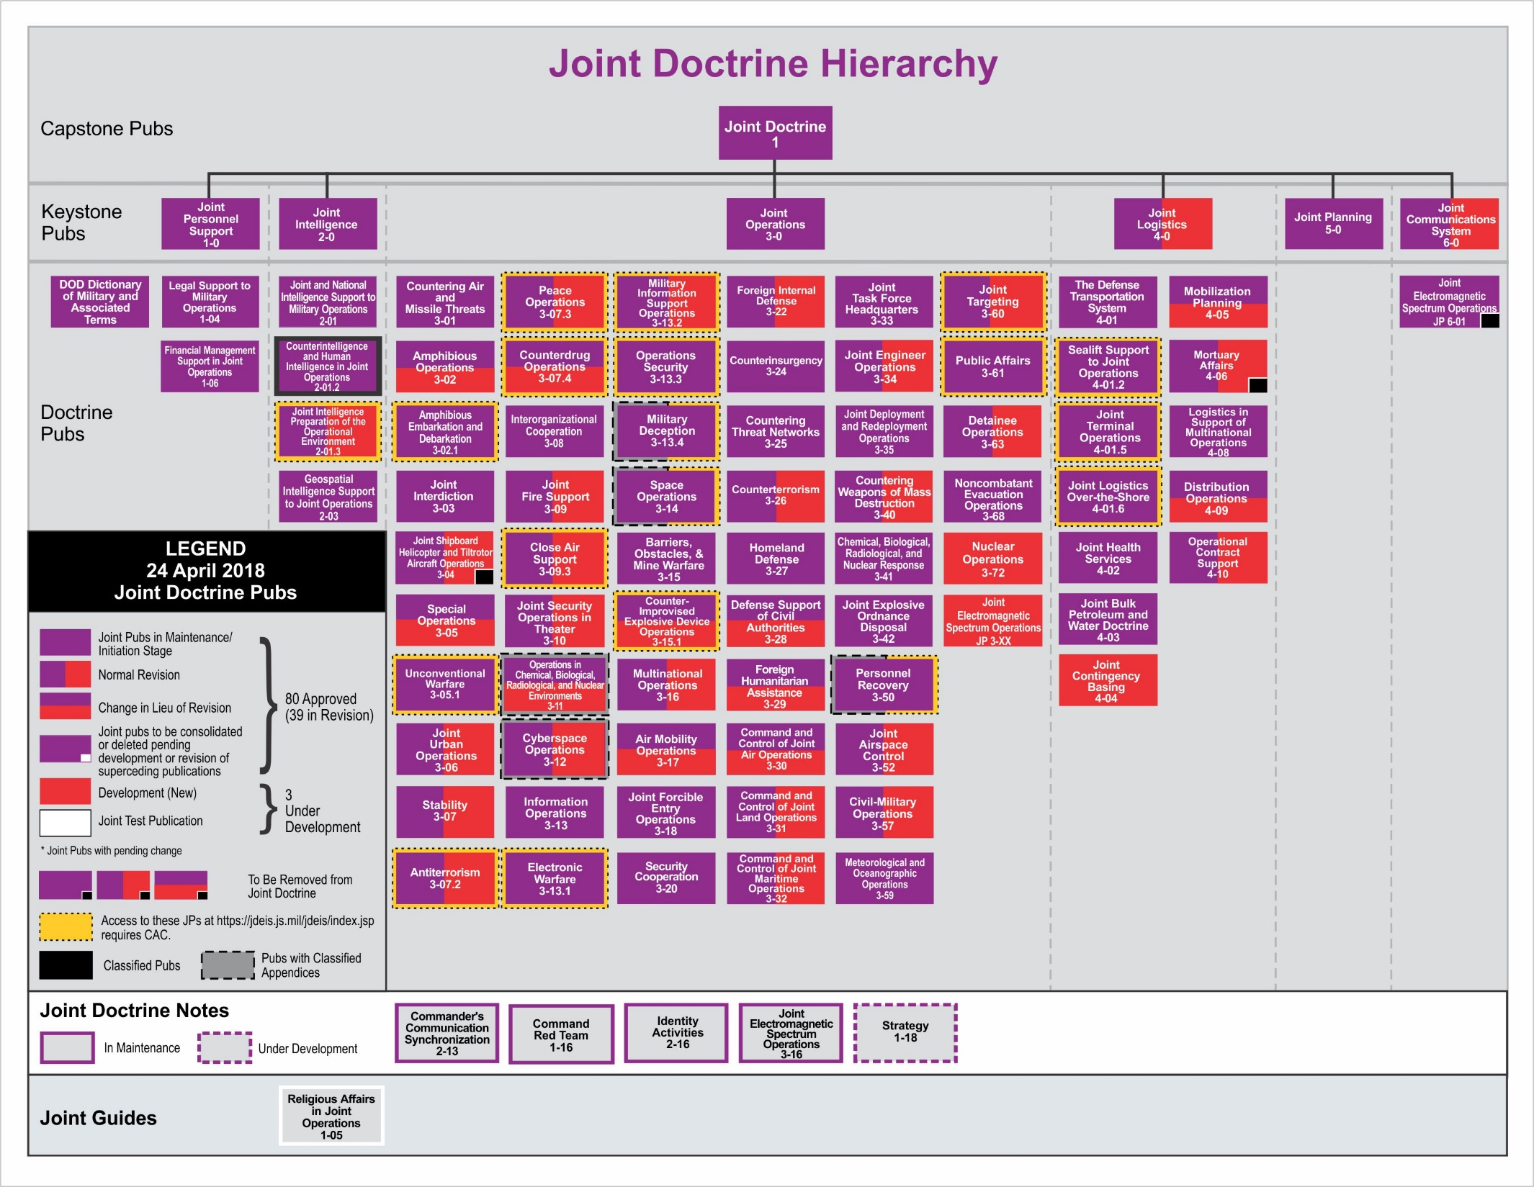

Slide 32
Joint Publication Doctrine
Provides authoritative body of consistent statements on:
How military forces conduct joint operations
How military plans are to be constructed
As well as a common lexicon:
Which must be used by military planners and leaders
Which will be what those charged with execution of military plans will anticipate and understand

Slide 33
Joint Publication Doctrine
not necessarily coherent
Provides authoritative body of consistent statements on:
How military forces conduct joint operations
How military plans are to be constructed
As well as a common lexicon:
Which must be used by military planners and leaders
Which will be what those charged with execution of military plans will anticipate and understand
...for humans...

Slide 34
Joint Publication 2.0 Definitions
Intelligence =_{def} The product resulting from the collection, processing, integration, evaluation, analysis, and interpretation of available information concerning foreign nations, hostile or potentially hostile forces or elements, or areas of actual or potential operations, as well as the activities that result in the product and the organizations engaged in such activities.
Joint Intelligence =_{def} Intelligence produced by elements of more than one service of the same nation.

Slide 35
Joint Publication 2.0 Definitions
Intelligence =_{def} The product resulting from the collection, processing, integration, evaluation, analysis, and interpretation of available information concerning foreign nations, hostile or potentially hostile forces or elements, or areas of actual or potential operations, as well as the activities that result in the product and the organizations engaged in such activities.
Counterexamples:
Redundant if ‘available’ means ‘accessible by investigation’
Overlooks acquisition if ‘available’ means ‘pre-existing’

Slide 36
Joint Publication 2.0 Definitions
Intelligence =_{def} The product resulting from the collection, processing, integration, evaluation, analysis, and interpretation of available information concerning foreign nations, hostile or potentially hostile forces or elements, or areas of actual or potential operations, as well as the activities that result in the product and the organizations engaged in such activities.
Counterexamples:
Police gather intelligence on domestic criminal activity
Companies gather intelligence prior to merger

Slide 37
Joint Publication 2.0 Definitions
Intelligence =_{def} The product resulting from the collection, processing, integration, evaluation, analysis, and interpretation of available information concerning foreign nations, hostile or potentially hostile forces or elements, or areas of actual or potential operations, as well as the activities that result in the product and the organizations engaged in such activities.
Counterexamples:
Intelligence ≠ Intelligence Gathering Activity
Agents getting proper sleep shouldn’t count as intelligence

Slide 38
Joint Publication 2.0 Definitions
Intelligence =_{def} The product resulting from the collection, processing, integration, evaluation, analysis, and interpretation of available information concerning foreign nations, hostile or potentially hostile forces or elements, or areas of actual or potential operations, as well as the activities that result in the product and the organizations engaged in such activities.
Counterexamples:
The CIA itself is not intelligence; it gathers intelligence
DIA’s HR department doesn’t gather intelligence

Slide 39

Joint Publications
Activity interoperability involves enforceable prescriptions
Prediction requires:
Real-time information sharing and revising
Common operational perspective
Interoperability across activities
Which will require:
New information support strategies
Semantic interoperability across data
New governance and training for both humans and machines

Slide 40
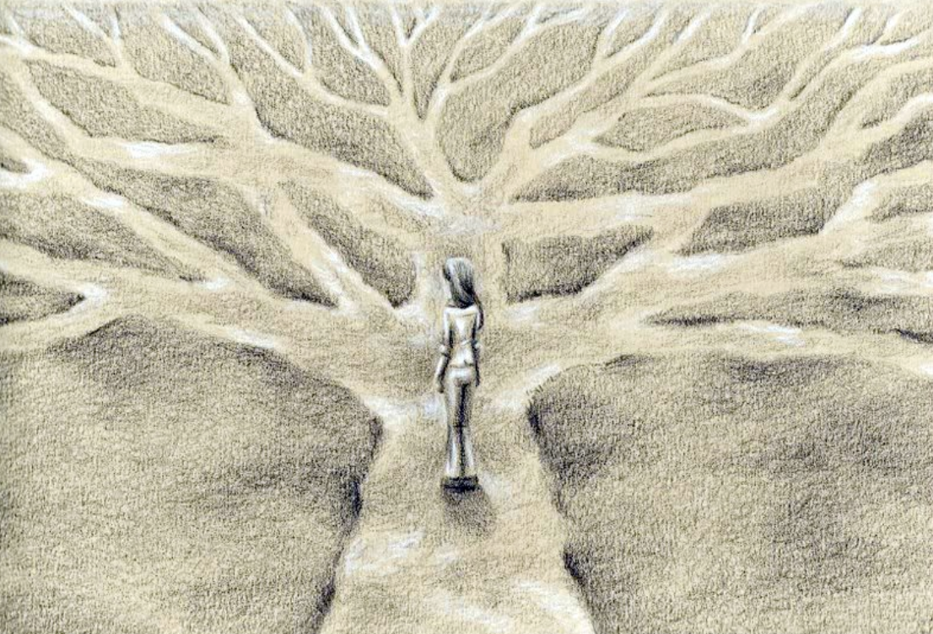
Moving from the words we use to the world we inhabit, is unlikely to lead us to the same destination

Slide 41
Joint Publication 2.0 Definitions
Intelligence =_{def} The product resulting from the collection, processing, integration, evaluation, analysis, and interpretation of available information concerning foreign nations, hostile or potentially hostile forces or elements, or areas of actual or potential operations, as well as the activities that result in the product and the organizations engaged in such activities.
More explicit than the definition for intelligence I have provided

Slide 42
Intelligence Definitions
Intelligence (JB) =_{def} Evidence acquired to justify beliefs obtained through intelligence gathering
Intelligence gathering (JB) =_{def} Covert behavior aimed at acquiring information to promote the interests of an individual or collective, using methods deemed reliable by the individual or collective
Intelligence (JP) =_{def} The product resulting from the collection, processing, integration, evaluation, analysis, and interpretation of available information concerning foreign nations, hostile or potentially hostile forces or elements, or areas of actual or potential operations, as well as the activities that result in the product and the organizations engaged in such activities.

Slide 43
Revised Intelligence Definitions
Intelligence =_{def} Evidence acquired to justify beliefs obtained through intelligence gathering
Intelligence gathering =_{def} Covert behavior aimed at acquiring information to promote the interests of an individual or collective, using methods of collection, processing, integration, evaluation, analysis, or interpretation deemed reliable by the individual or collective

Slide 44
Group Exercise
Gather into groups and reflect on the definitions for intelligence and intelligence gathering provided
Weight the costs and benefits of the suggested revision, leveraging counterexamples where possible to illustrate
Provide suggested improvements to the definitions

Slide 45
Joint Publication Doctrine
not necessarily coherent
Provides authoritative body of consistent statements on:
How military forces conduct joint operations
How military plans are to be constructed
As well as a common lexicon:
Which must be used by military planners and leaders
Which will be what those charged with execution of military plans will anticipate and understand
...for humans...

Slide 46
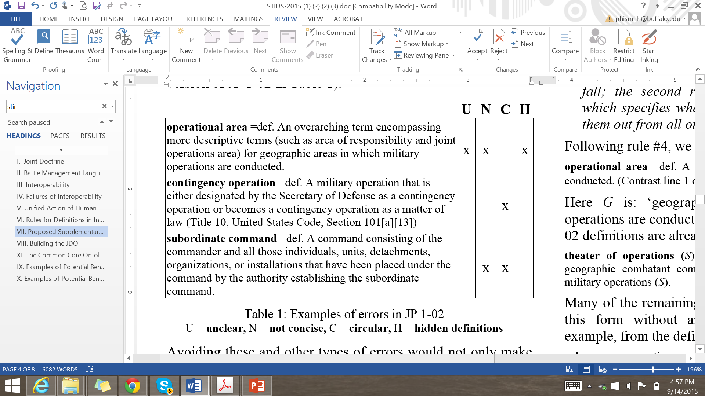
Joint Publication Definition Guide
A definition should:
not be over-restrictive
not be circular
be positive
contain no hidden definitions

Slide 47
Group Exercise
Gather into groups and reflect on the definitions provided from the Joint Publication doctrine
Evaluate whether these definitions respect the definition creation guidance introduced
If so, explain why; if not, provide a counterexample

Slide 48
Joint Publication Definition Guide
A definition should:
not be over-restrictive
not be circular
be positive
contain no hidden definitions

Slide 49
Joint Publication Definition Guide
A definition should:
not be over-restrictive
not be circular
be positive
contain no hidden definitions

Slide 50
Moving from the words we use to the world we inhabit, is unlikely to lead us to the same destination

Slide 51
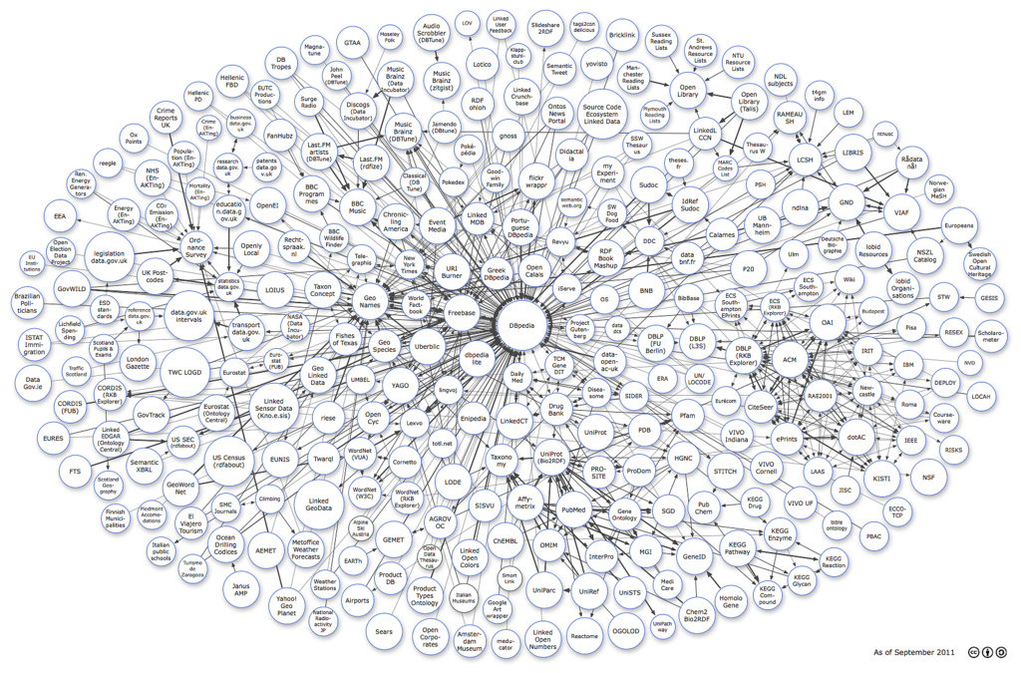
Controlled Vocabularies
Standards such as the Joint Doctrine Publications help humans use, understand, and create representations of reality
And computers process representations of reality and connect data
But they are only able to serve these purposes if developed in a coordinated, coherent, fashion

Slide 52
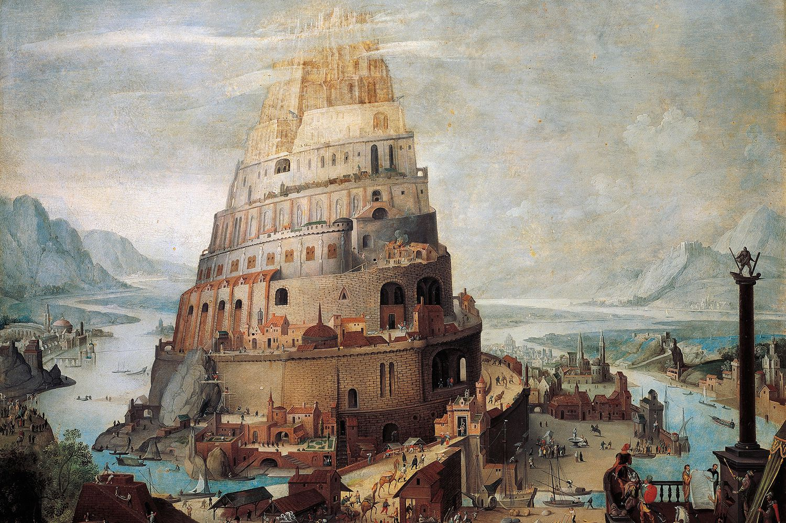
Controlled Vocabularies
Standards such as the Joint Doctrine Publications help humans use, understand, and create representations of reality
And computers process representations of reality and connect data
But they are only able to serve these purposes if developed in a coordinated, coherent, fashion

